Slide 2
http://astro.cas.cz/bh2010/program
Probing strong gravity in stellar mass black holes Probing strong gravity in super-massive black holes Probing strong gravity in the Galactic centre Observational perspectives and future techniques

Slide 3
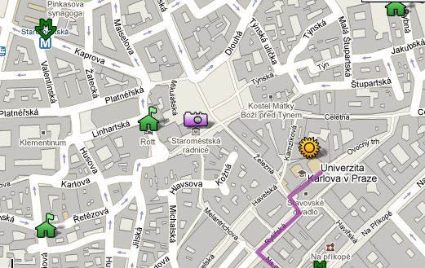
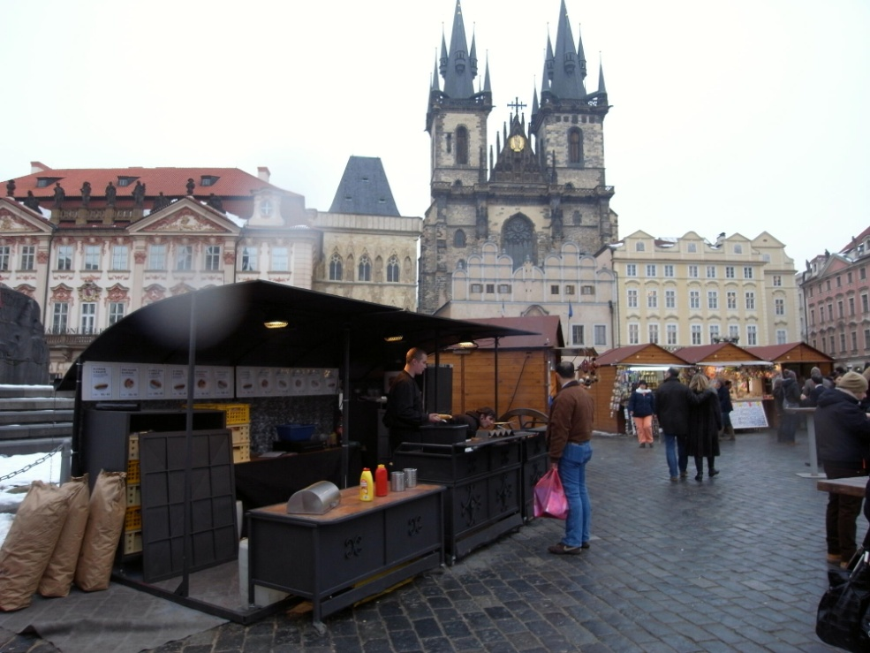
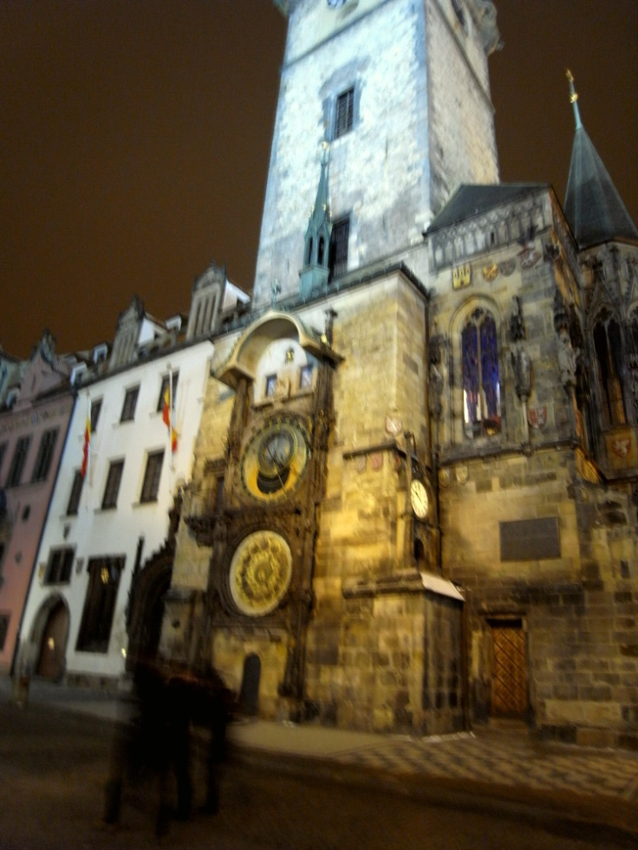
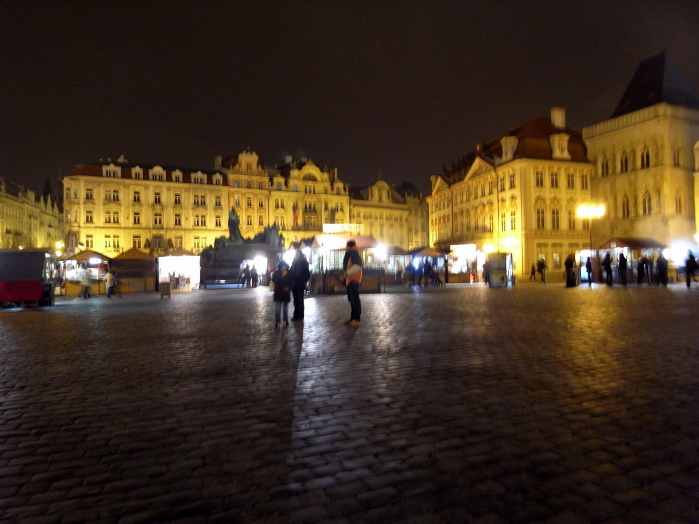

Slide 4
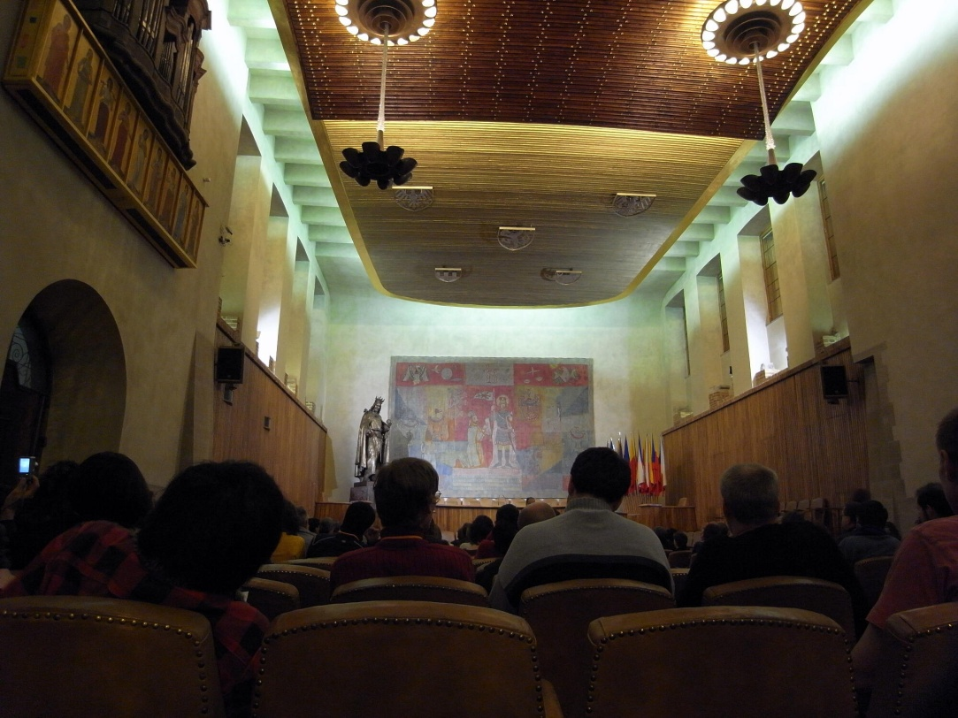
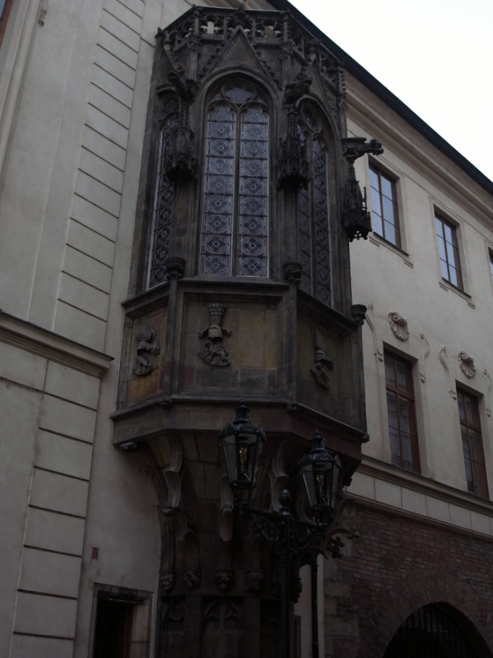
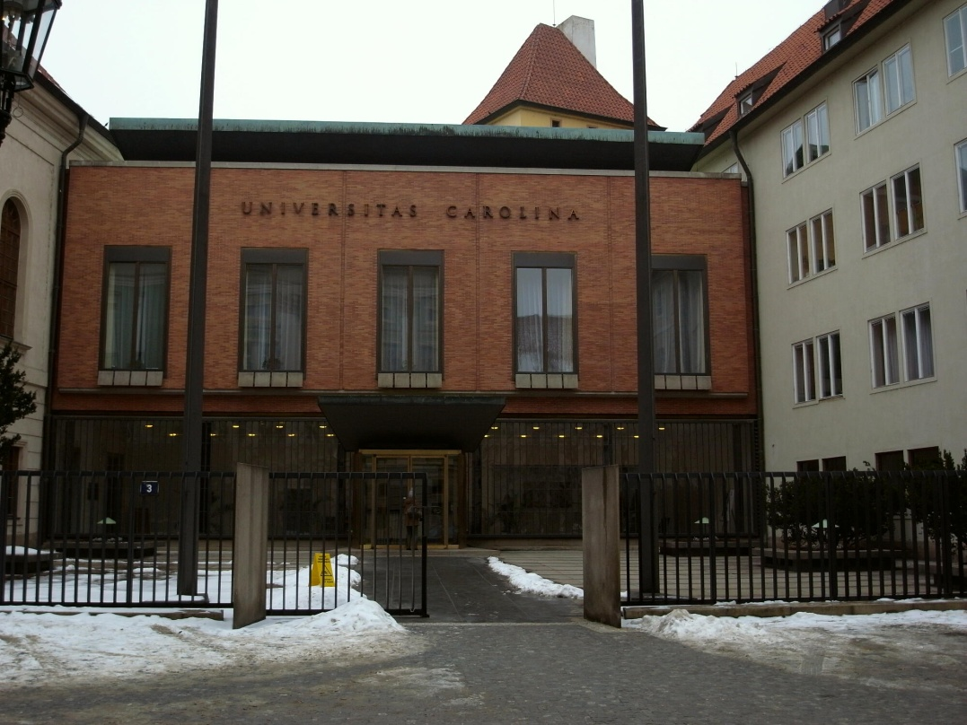

Slide 5
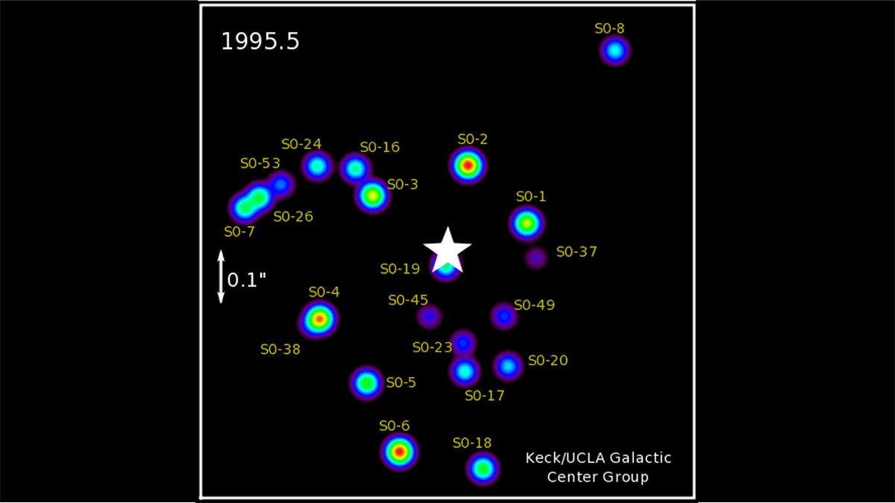
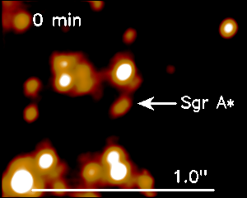
近赤外線による近傍星の観測：Shodelのトークから

Slide 6
Shodelのトークから

Slide 8
将来の赤外観測可能性simulation
Shodelのトークから

Slide 9
2010.Feb.17th＠Prague
A First Black Hole Imager at Andes
Makoto Miyoshi
(National Astronomical Observatory, Japan)
With
J. Nakajima, M. Sekido, Y. Koyama, H. Ujihara, Y. Irimajiri (NICT), H. Ishitsuka (IGP), Y. Asaki, Y. Kato, M. Tsuboi (ISAS), T. Kasuga (Hosei Univ.), A. Tomimatsu (Nagoya Univ.), M. Takahashi (Aichi Univ. Edu.),Y. Eriguchi,
S. I. Yoshida (Tokyo Univ.), S. Koide (Kumamoto Univ.),
R. Takahashi (RIKEN), T. Oka (Keio Univ.), R. S. Furuya,,
N. Kawaguchi, K. Niinuma (NAOJ).

Slide 10
If we construct a sub-millimeter wave VLBI array around Andes, we can observe the black hole of SgrA*.
We are planning a three –stations array around Peruvian Andes, dedicated to the detection of the event horizon of SgrA*, around US$ ten-million-level.

Slide 11
The existence of the black hole in the universe was confirmed in the last century. The best three convincing black hole are: M87 NGC4258 (M106) SgrA* (Our Galactic Center)

Slide 12
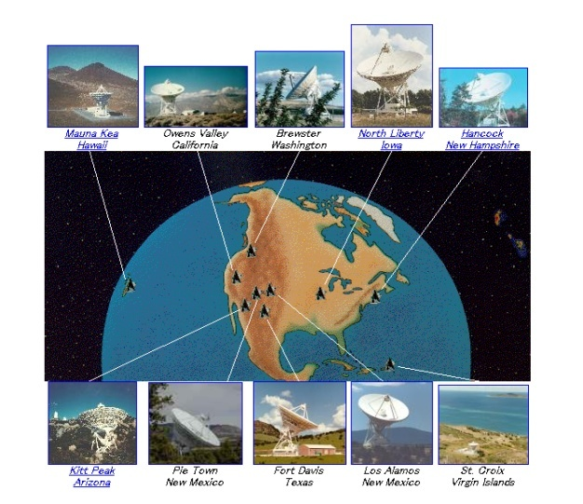
Using the VLBA, a high velocity Keplarian disk around the core was found. More than 1000km/sec at the radius of 0.13 pc means that the central mass exceeds 3.9 ×１０^{７}Ｍsun. Only within the radius of 0.3 ly 3.9×10⁷ solar mass exists such a high density cannot be explained without black hole.
NGC4258, VLBA, MBH=3.9×10⁷M sun
Herrnstein et al. 1999
Miyoshi et al. 1995
Nakai et al. 1993

Slide 13
From the dynamical measurements, all people believe the existence of black holes in the universe today, except relativists. But, no one has observed them.

Slide 14
Observing black hole shadow
(event horizon) is the conclusive evidence of black hole even relativists can be persuaded and a new approach investigating strong field gravity.

Slide 15
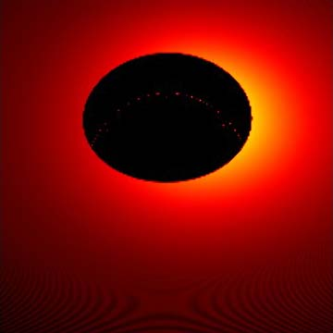
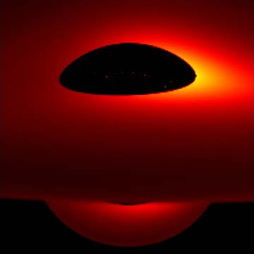
Kerr ADAF（H=1)、 Axis symmetric
Black Hole Metric(mass, spin, charge) governs
the Shape of Black Hole Shadow （R. Takahashi, 05).
２３０GHｚ
SgrA*
i＝４５° i＝８０°(almost edge on view)
Schwarzschild
ADAF
(H=1)
Axis symmetric
Takahashi
et al. (04)
12Rs

Slide 16
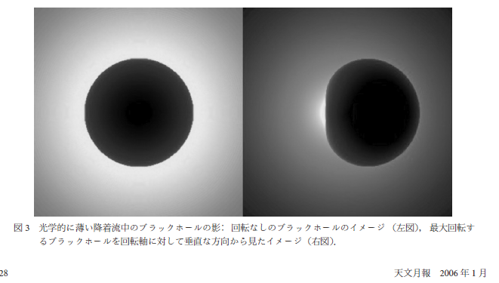
The effect of spin on black hole shadow
No Spin
Maximum Spin
R. Takahashi (2004,2005)

Slide 17
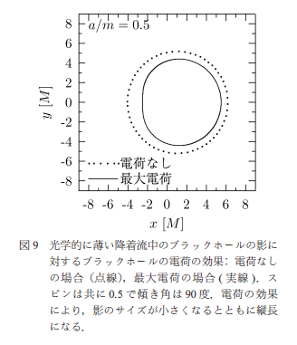
The effect of charge on black hole shadow
Black hole shadow
is governed only by the black hole metric.
From the shape of black hole shadow,
We can measure the metric (mass, spin, & charge) of the black hole directly!
No charge
Maximum charge
R. Takahashi
(2004,2005)

Slide 18
Can we observe black hole?
Yes, we can
with VLBI observations of SgrA*
at sub-millimeter wavelength!

Slide 19
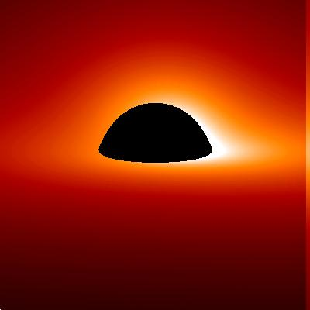
Shadow Size of Black Holes
～５Rs
～５Rs
SgrA*, central massive black hole at our galactic center has the biggest apparent size of Rs=6-10μａｓ. （Schwarzschild case）

Slide 20
SgrA* has been investigated by VLBI again and again with cm to mm wave lengths, but all astronomers failed to get the black hole (shadow) image. Because the frequency channels they observed were different channel for receiving Black-hole-broadcasting. So we only have to select the correct broadcasting black-hole channel.

Slide 21
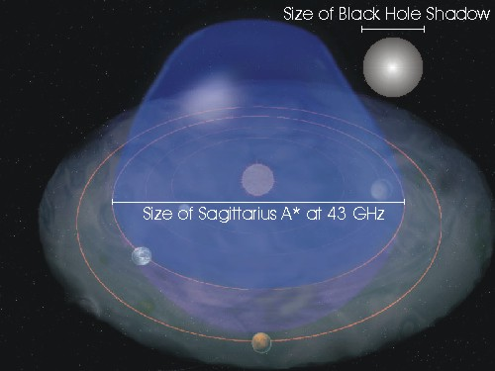
The Size of SgrA* system is comparable to our Solar System.
http://www.astro.ru.nl/~falcke/bh/Pictures/sgrastar-size-solarsystem-small.jpg

Slide 22
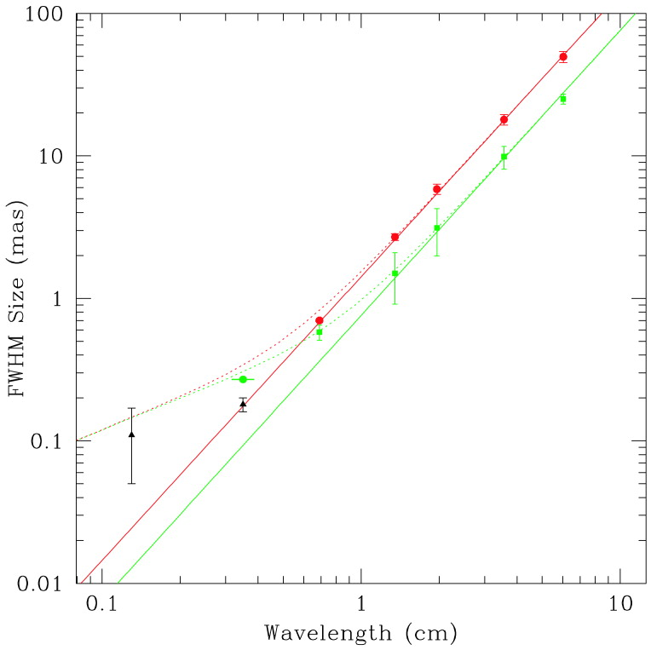
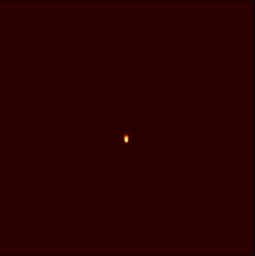
Apparent Size Measurements of SgrA*
At low frequency, SgrA* image is scattered by plasma（∝λ＾２）.
But
free from scattering
at sub-mm wave length !
So we can expect observe the intrinsic image.
Deviation occurs at high frequency.
Doelman et al. （2001）

Slide 23
For Imaging a Black Hole:
The most promising source is SgrA*.
We need sub-millimeter VLBI observations (230~340GHz) because free from scattering effect.
We need the southern hemisphere array for good uv coverage for SgrA* (10 stations, 8000km extent @230GHz).
The required sensitivity is already attainable from the viewpoint of present technology.
We need good sites like that of ALMA for sub-millimeter VLBI array.

Slide 24
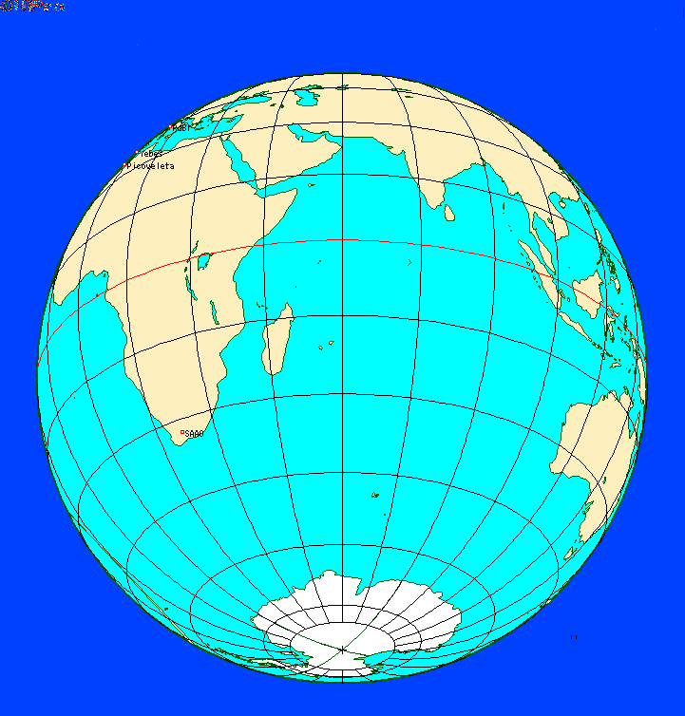
The Earth Rotation seen from SgrA* (δ=-30°)

Slide 25
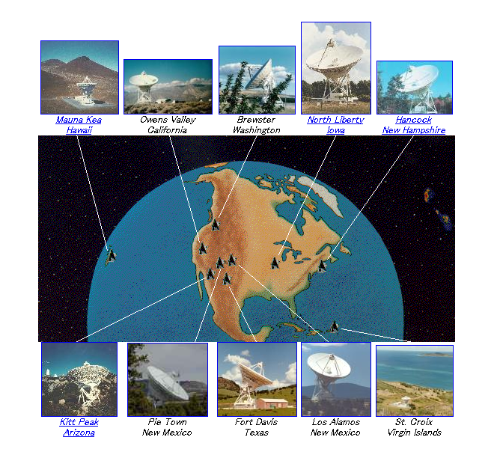
The Earth Rotation
seen from SgrA* (δ=-30°)
VLBA
( US, North America)
Short observing time, bad condition due to low elevation

Slide 26
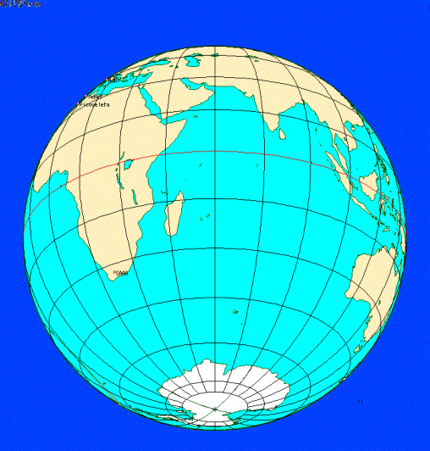
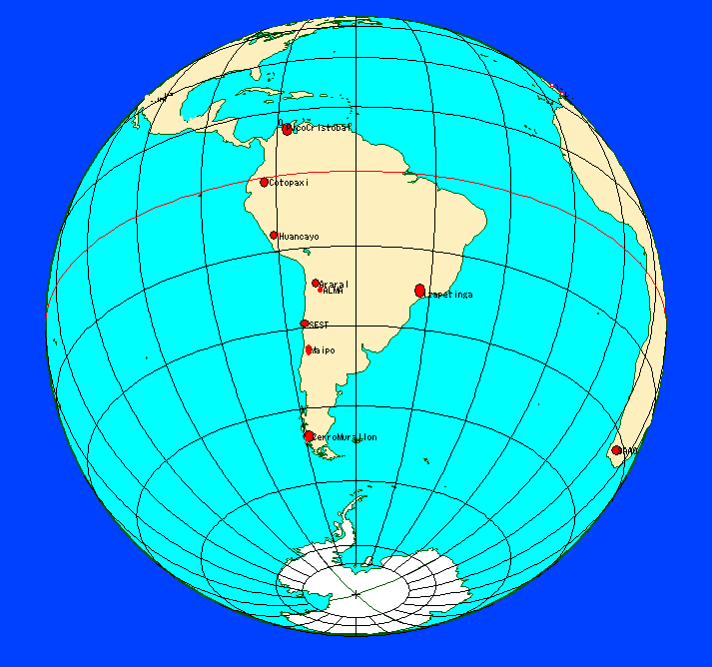
Virtual southern array Horizon telescope (10 stations)
The uv coverage seems enough for SgrA* ?
Horizon Telescope @ Andes
Longer observing time, good condition due to high elevation

Slide 27
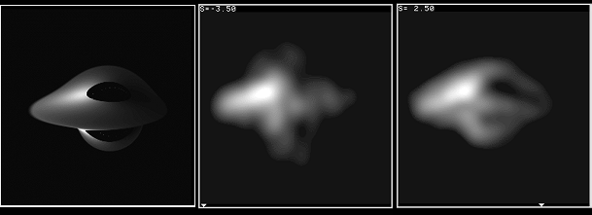
SgrA*
230GHz
Model Image
The case of VLBA
Location
The Horizon Telescope
at Andes
250 μas
Both array has 10 stations and 8000km
Extent, but the better image is obtained
from the Horizon Telescope at Ands.

Slide 28
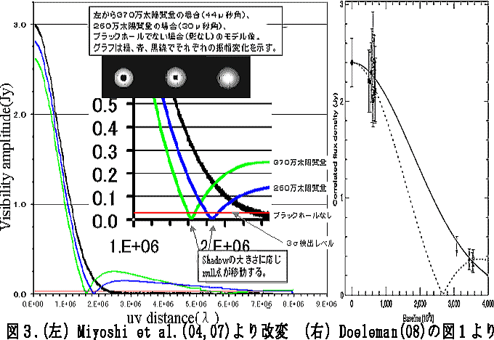
Technical feasibility is now within our hands.
Doeleman (2008) reported the fringe detection at 230GHz
VLBI experiment from SgrA* observation.

Slide 29
Here,
we emphasize the importance of
shorter baselines
in VLBI SgrA* observations.

Slide 30
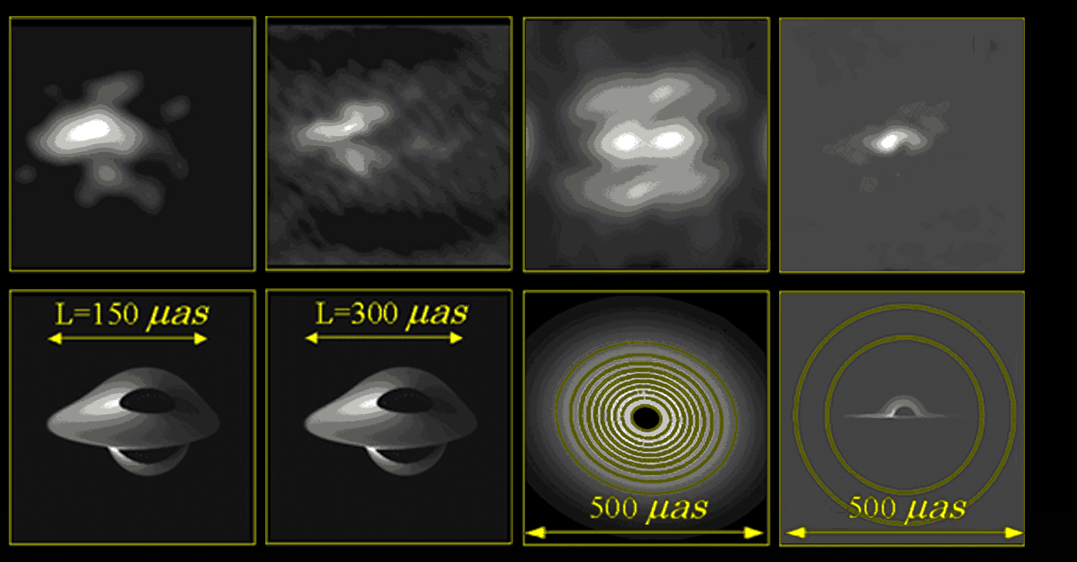
Even now, longest baseline s are available (～8000km）, but still difficult to image SgrA* black hole. We need SHORTER baselines!
↑ VLBI Simulation Maps using present sub-mm Telescopes.
Lower Model Images, Upper Resultant maps. {Hawaii, West Coast, ALMA(1 element),＋Virtual Peruvian + closed SEST }
=Not enough uv-coverage, Lack of shorter base lines＝

Slide 31
Andes around ALMA is suitable place of the sub-mm VLBI network
with short baselines
for SgrA*.

Slide 32
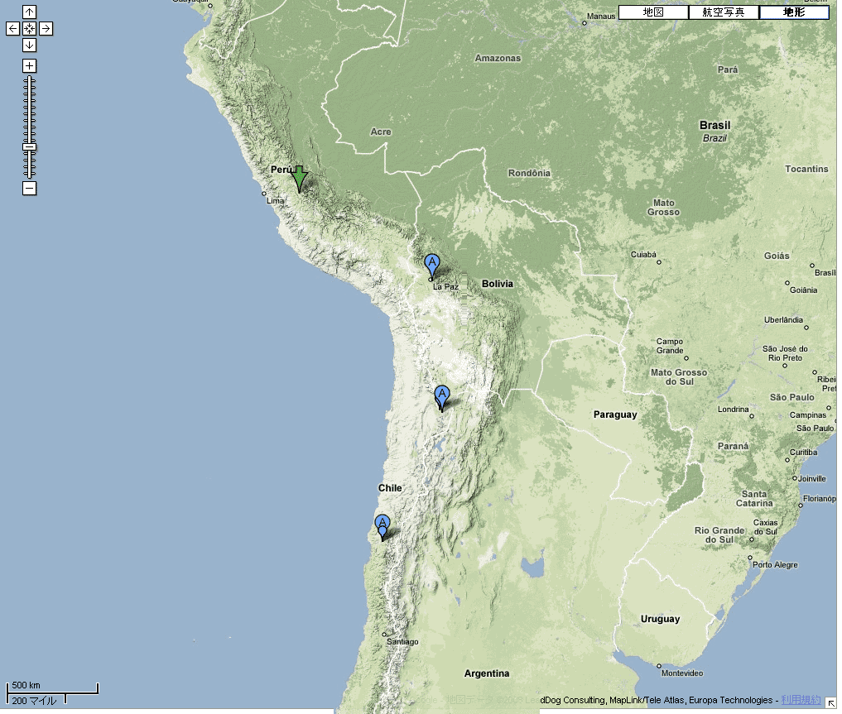
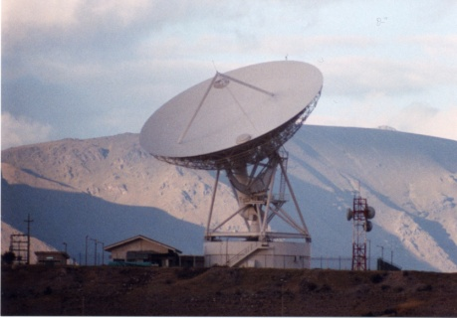
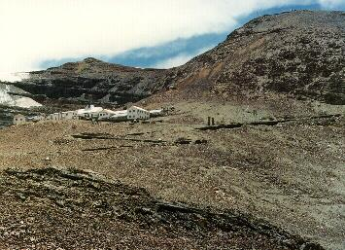
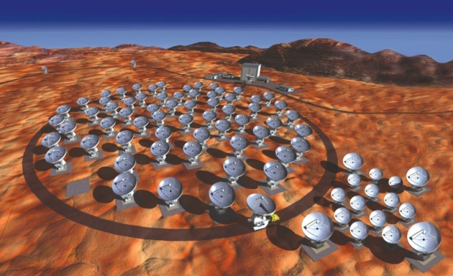
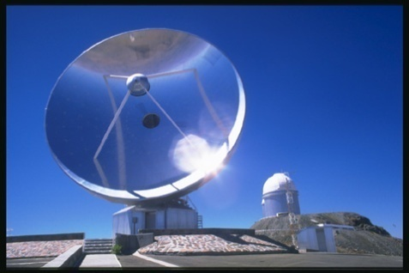
Telescopes around ALMA give us
shorter (<2000km) baselines!
Huancayo
Peru
Huancayo
3300m
900km
Near Bolivia La Paz 5300m
The highest Ski Slope in the world
Cosmic Ray Observatory
Cerro Chacaltaya
ALMA
?Mirabel station 4600m
La Silla 2400m
SEST15m鏡 (Closed, but alive)
ALMA

Slide 33
So constructions of new sub-mm VLBI stations around ALMA are very important for SgrA* Black Hole Imaging.
Cost?!

Slide 34
We are planning 3-stations VLBI with very low cost around 10 million-level, because we are in the big monetary crisis occurred once a century.
「Japan is in a big monetary crisis occurred once a century.」
(2008)
「People’s livings are
more important than concrete ｣(2009) presumably “concrete” includes science.

Slide 35
A First Black Hole Imager at Andes:
Usage of Large Spherical Dish for Sensitivity , 30 m-class, Tracking possible several hours.
at Chacaltaya & Huancayo.
Low cost. Ex, Daishido 30m & 20m*8 dishes.
(2) Usage of Mobile Small Dish for collecting uv- cover
4-m class mobile station around Andes mountains.
Experiences of NICT for geodetic mobile VLBI station with small antenna.
(3) Dedicated only to SgrA*, aiming at the detection of the black hole shadow (event horizon).

Slide 36
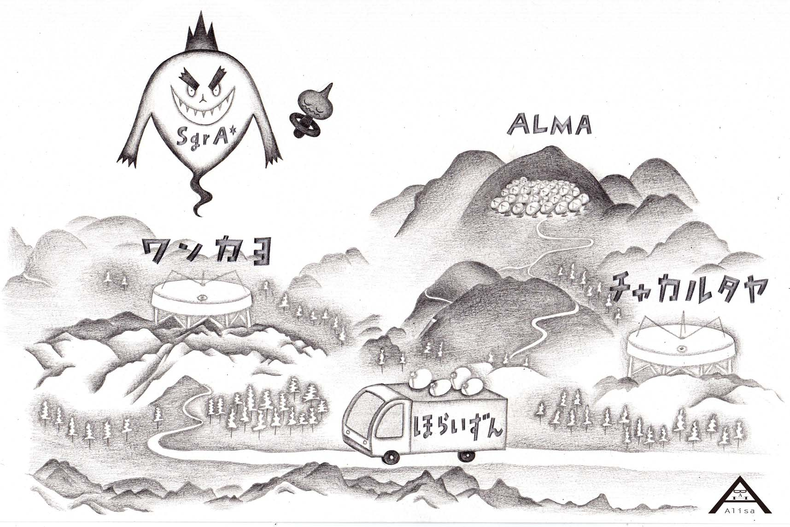
Concept Illustration
of our sub-mm VLBI
装置概念図
Huancayo/Peru
Chacaltaya /
Bolivia
Large Spherical Dish
Large Spherical Dish
Mobile VLBI station

Slide 37
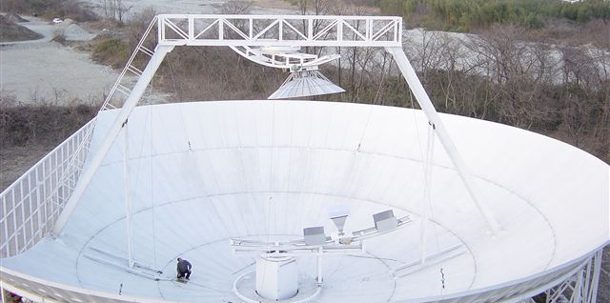
Prof. Daishido (Waseda Univ) constructed the 30m Dish at Nasu in Japan cost ￥4000万
RF<10Gz
Spherical main dish has no exact focus, but by a use of aspherical
sub-reflector, we can get a focus. By shifting sub-reflector we can
track objects for several hours. Fixed main dish is free from
deformation by EL tilting. Surface shape is common -easy to make.

Slide 38
Geodetic VLBI mobile station was developed by NICT
←NICT Kashima
An experience of making a
small cheap sub-mm dish
by Ogawa.

Slide 39
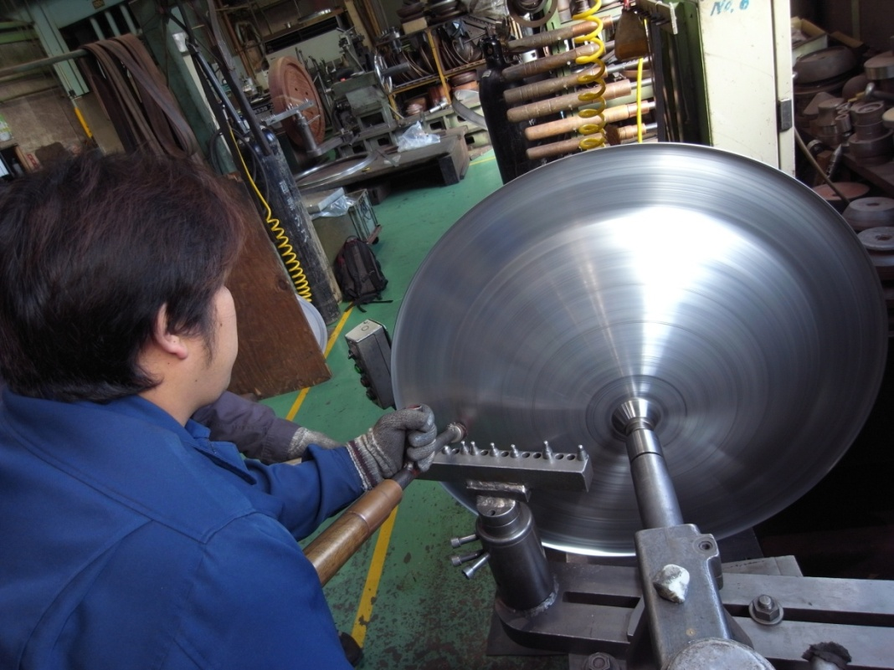
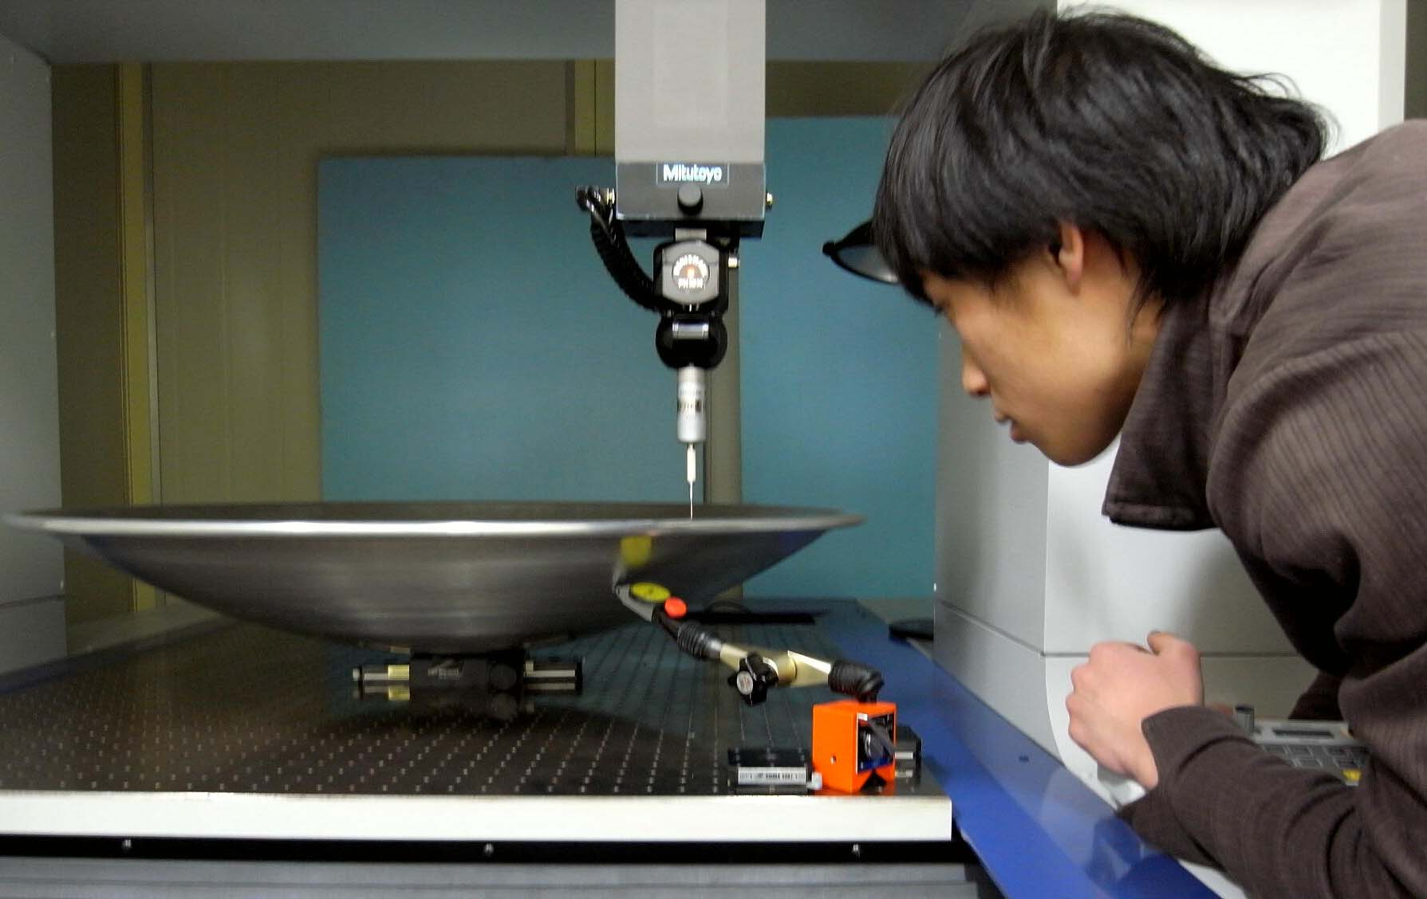
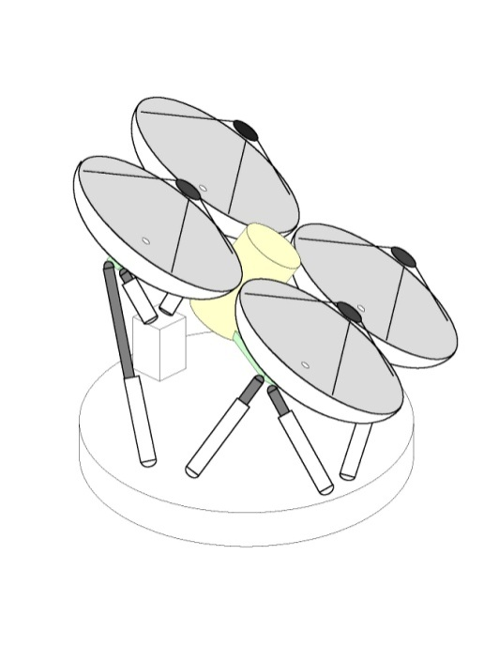
北嶋絞製作所
（東京羽田・09年11月）
Surface accuracy measurement.
製作費4万円
Concept figure
A new attempt to make a sub-mm dish with very low cost by Kasuga: we are aiming to get a 100μm rms (for 230 GHz use）.

Slide 40
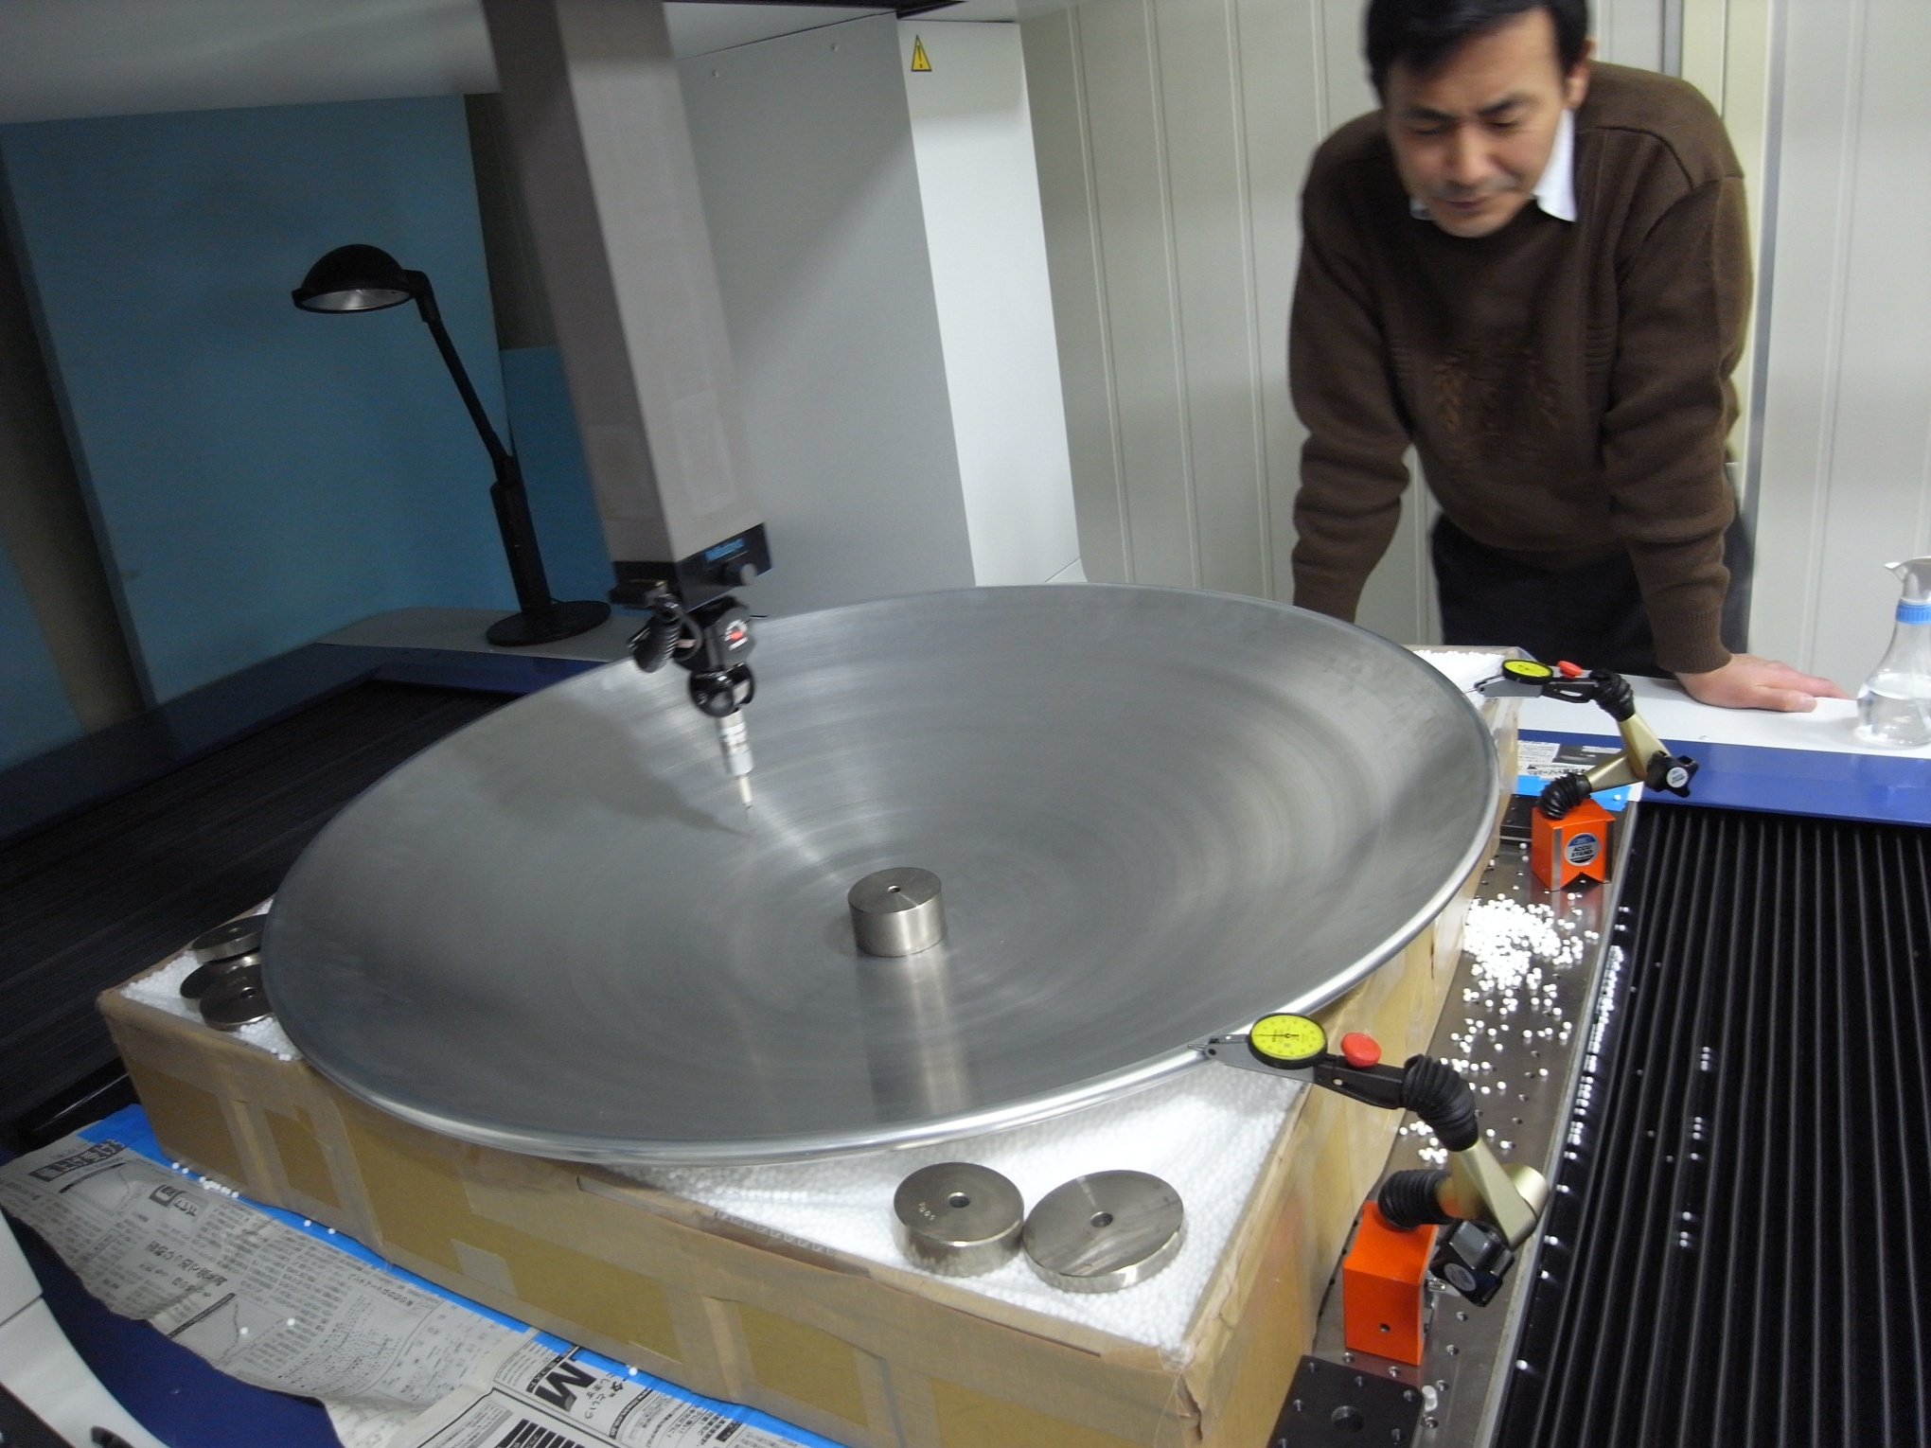

Slide 41
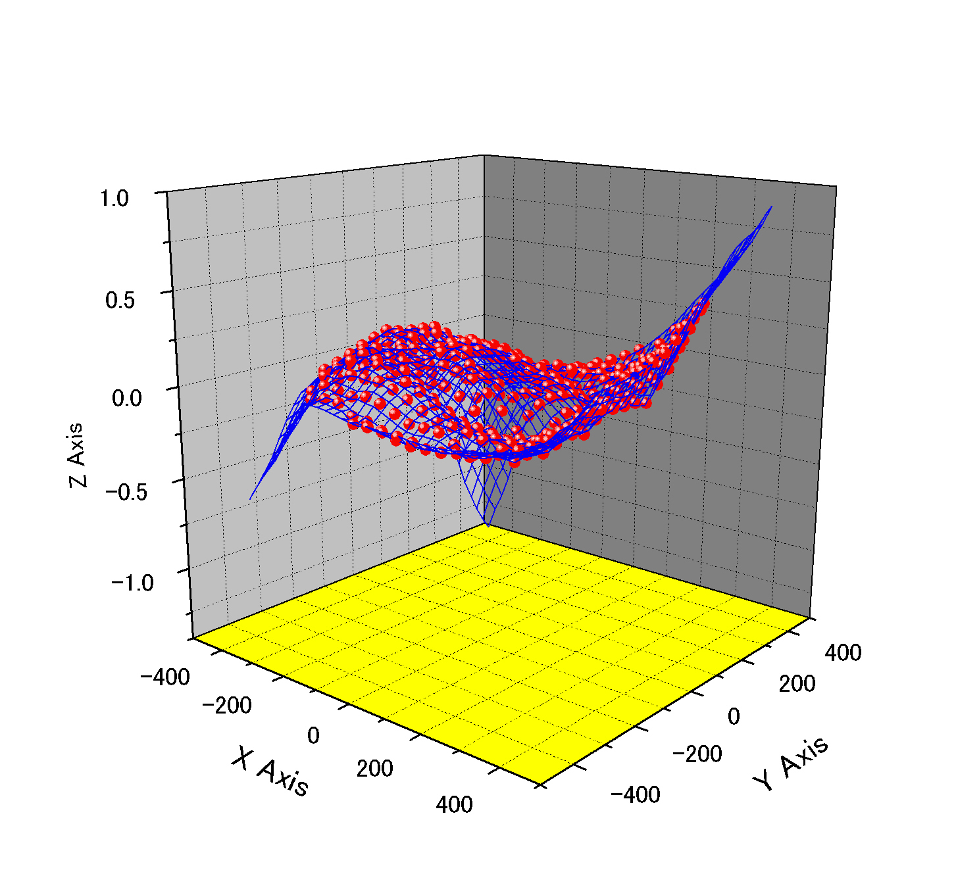
残差はすでに120ミクロンr. m. s.。だが
全体的に3次関数群で示せるゆがみがある。

Slide 42
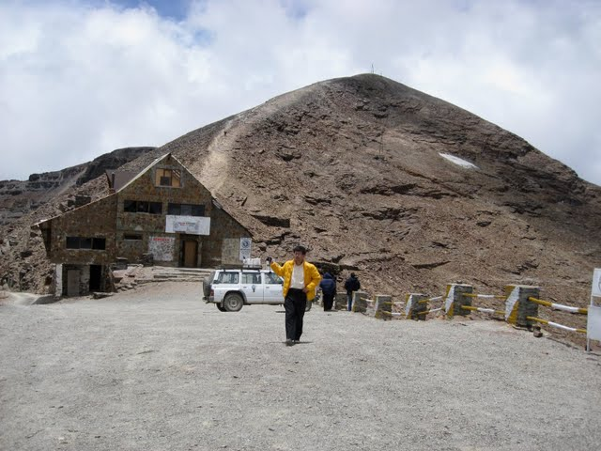
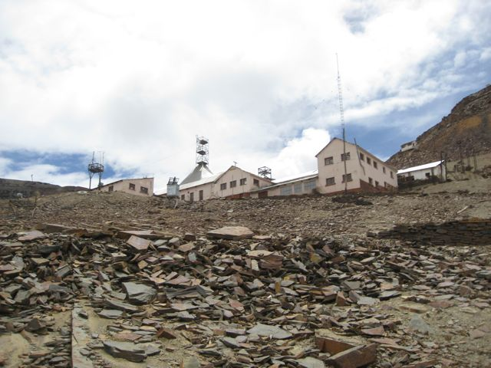
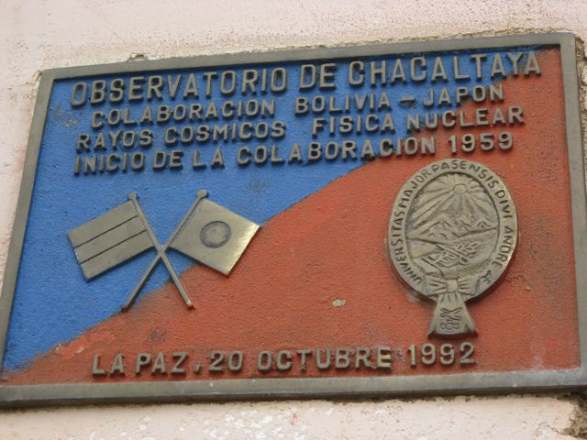
Chacaltaya
Cosmic ray Observatory
At 5300 m (La Pas, Bolivia)
Here we wish to build a new radio telescope.

Slide 43
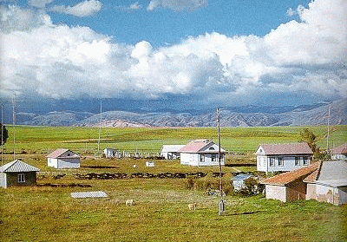
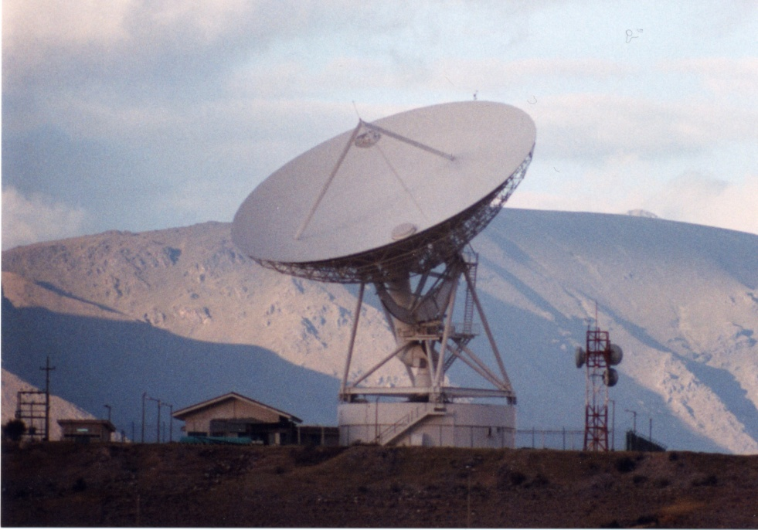
Observatorio de Huancayo, IGP
Latitud: -12.037875� N -1.80� N
Longitud: 284.681633� E -3.46� E
Altitud: 3336.0 m.s.n.m.
The other site candidate,
Huancayo in Peru
32-m telecommunication antenna
-- Not for sub-mm observation --

Slide 44
装置概念図
We hope to detect an event horizon by the 100 years’ anniversary of general relativity in 2016.
Huancayo/Peru
Large Spherical Dish
Large Spherical Dish
Chacaltaya /
Bolivia
Mobile VLBI station

Slide 45
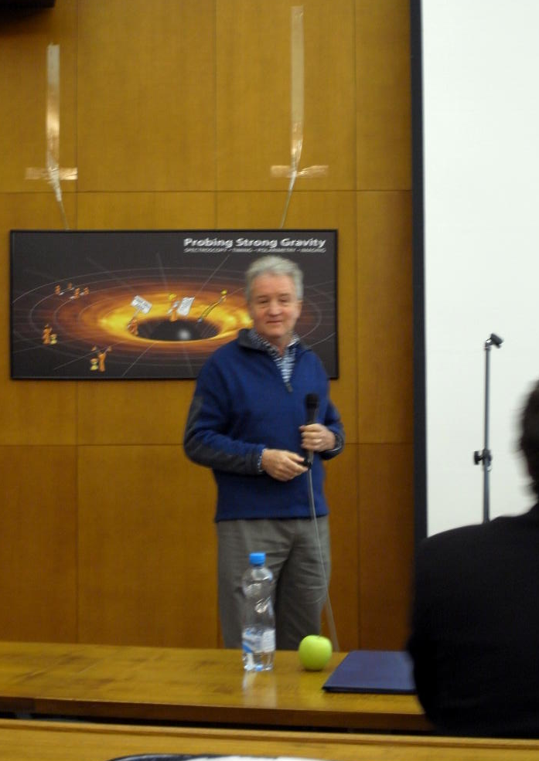
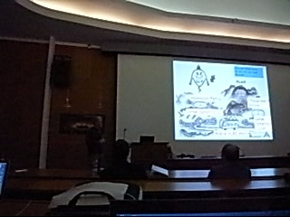
サマリトーク：
Fabian先生激賞！

